Slide 1
3 MONTH KP VERIFICATION FAILURES INVESTIGATION

Slide 2
Issue Definition
What We Know
Analysis
Investigations
Conclusions
Actions Taken
Recommendations

Slide 3
Issue Definition
19% of the sealed KOKOPoints have failed the 3 month verification exercise conducted by Systems Group on behalf of Weights & Measures.
The 3 month verification is to ensure the fuel dispense accuracy is within the Maximum Permissible Errors (MPE)
NB: Data source - DB and KP Calibration Reports

Slide 4
What We Know
19% of verified KPs have failed (34 out of 146) as of 14th February 2020.
30 out of the 34 failures were due to over dispensing.
Maximum Permissible Errors(MPE):
VOLUME (ml) | MPE (%)
300 | ± 2.67
500 | ± 2
1000 | ± 2
2000 | ± 1

Slide 5
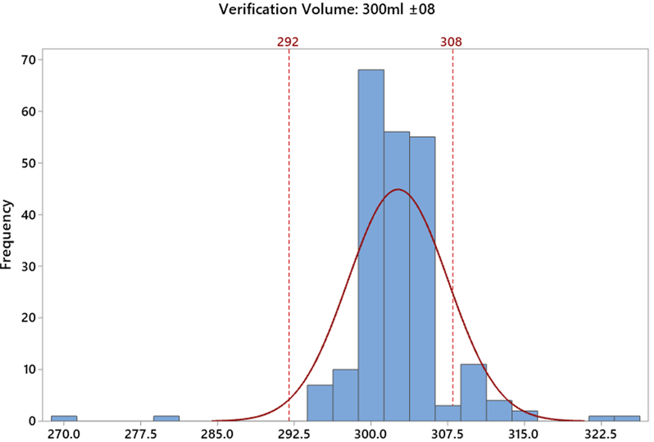
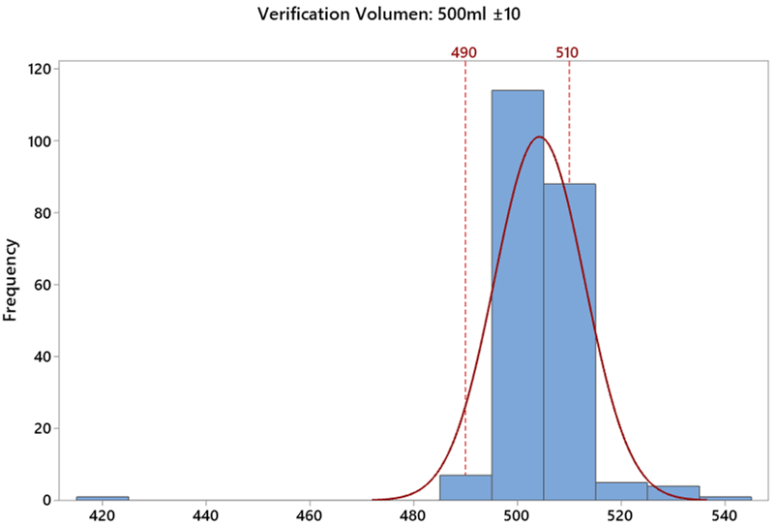
Verification Data Volume (300 and 500mls)

Slide 6
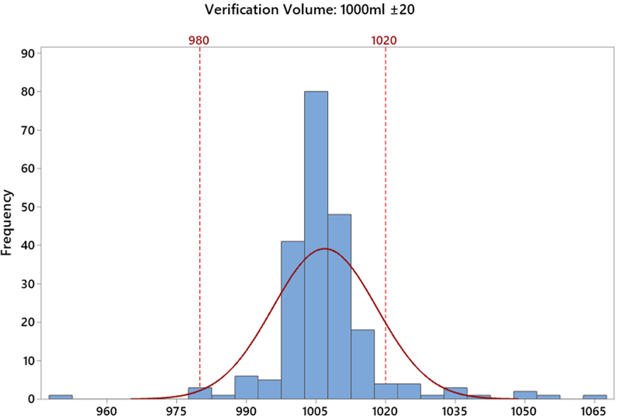
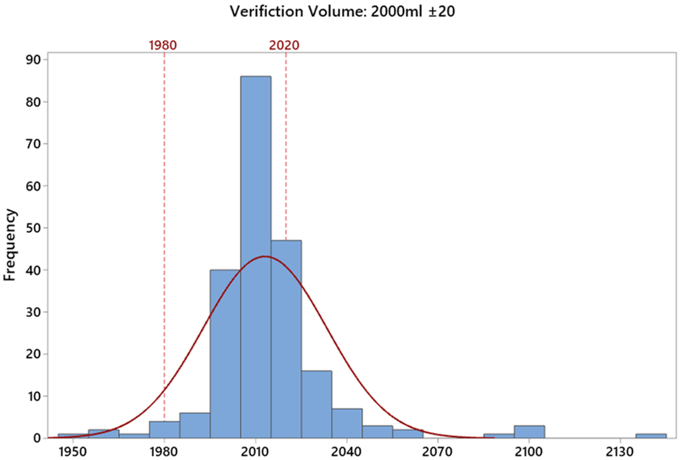
Verification Data Volume (1000 and 2000mls)

Slide 7
What We Know Cont’d
Volume Failure Analysis
Volume | 300ml | 500ml | 1L | 2L
Failure Counts | 15 | 14 | 13 | 26
% (of the total failed KPs) | 50.00% | 46.67% | 43.33% | 86.67%
10 KP’s (33%) out of the 30 failed only on one volume, 2L dispensed beyond max MPE.

Slide 8
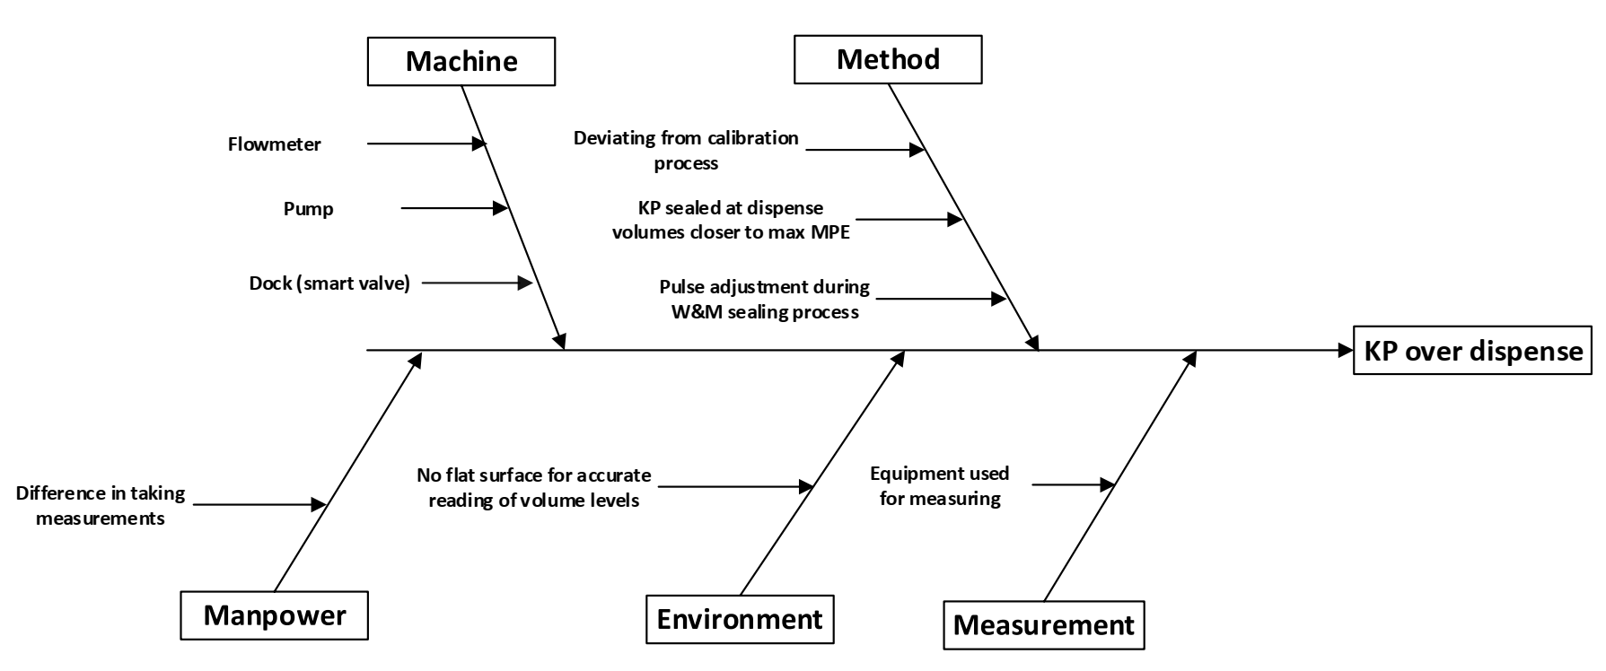
KP OVER DISPENSE FISHBONE ANALYSIS

Slide 9
ROOT CAUSE PRIORITIZATION MATRIX
Root Cause | Probability of Occurrence | Severity Level | Ease of Detection | Cumulative Scale
Pulse adjustment during W&M sealing | 4 | 4 | 5 | 80
KP sealed at dispense volumes closer (2ml to 5ml) to maximum MPE's | 4 | 4 | 4 | 64
Deviating from Calibration Process | 3 | 5 | 4 | 60
Flat surface for volume reading | 3 | 4 | 2 | 24
Flowmeter | 2 | 5 | 1 | 10
Pump | 2 | 2 | 2 | 8
Dock (smart valve) | 2 | 2 | 2 | 8
Equipment used | 2 | 2 | 2 | 8
Difference in taking measurements | 2 | 1 | 2 | 4
 | Scale
 | Probability of occurrence | Severity Level | Ease of detection
1 | Impossible | Very Low | Very High
2 | Unlikely | Low | High
3 | Even Chance | Moderate | Moderate
4 | Likely | High | Low
5 | Certain | Very High | Very Low
The top 3 root causes to be investigated further:
Pulse adjustment during W&M sealing
KPs sealed at dispense volumes closer to max MPE’s (still under investigation)
Deviations from the calibration process by calibration technicians

Slide 10
Investigation: Pulse Adjustments during W&M sealing
KP S.No | Verification Status | Adjusted During W&M | Pulses Adjusted Upwards/Downwards?
KP-0238 | Fail - all OD | Yes | Upwards for 2L only
KP-0482 | Fail- all OD | Yes | Upwards for all vols
KP-0047 | Fail - all OD | No
KP-0354 | Fail - all OD | Yes | Upwards for all vols
KP-0060 | Fail - all OD | No
KP-0448 | Fail -0.5L UD | Yes | Upwards for all vols
KP-0164 | Fail - only 2L OD | No
KP-0362 | Fail - 3 vols OD | Yes | Upwards for all vols
Analysis was done on samples KP’s which failed the verification to identify if there was any re-calibration/adjustment the day when W&M sealed the KP and whether there validation was carried out afterwards.
NB: OD - Over Dispense
UD - Under Dispense
 | Adjustments During W&M Sealing |  |  |  |  |  |  | Error During 3 Month
 | Adjustment on 300ml (Pulses) | Adjustment on 1L (Pulses) | Adjustment on 2L(Pulses) | Adjustment on 300ml (ml) | Adjustment on 1L (ml) | Adjustment on 2L(ml) | Adjustments validated? | Verification Error in 300ml | Verification Error in 1L | Verification Error in 2L | Adjustment proportional to dispense error?
KP-0238 | 0 | 0 | 6 | 0 | 0 | 2 | Yes | 5 | 16 | 35 | No
KP-0482 | 37 | 124 | 101 | 12 | 41 | 34 | Yes | 25 | 55 | 140 | No
KP-0354 | 16 | -32 | 10 | 5 | -11 | 3 | Yes | 10 | 35 | 37 | No
KP-0448 | 0 | 58 | 111 | 0 | 19 | 37 | Yes | 0 | 7 | 12 | No
KP-0362 | 0 | 0 | 70 | 0 | 0 | 23 | Yes | 5 | 38 | 100 | No
NB: Data source - DB and KP Calibration Reports

Slide 11
Investigation: Deviation from Calibration Procedure
Though hard to prove after occuring, it’s possible for a deviation from the calibration procedure to occur in the following ways;
Entering the wrongly calculated adjustment pulses directly into the interface
Entering the wrong volume.
Failure to properly validate a pulse adjustment.
Feedback from the calibration technicians was that occasionally, they get a different dispense volume when dispensing via the calibration interface and when dispensing via the customer interface. This however improves by the second or third dispense.
Re-calibrations and dispense accuracies done during W&M sealing are undocumented
NB: Data source - DB and KP Calibration Reports

Slide 12
Under Investigation: Sealing at Volumes Close to MPE Limits
Introduced capturing dispensed volumes during W&M sealing via the calibration mobile app for data traceability and continuity.
Dispense volumes (3 averages) from 7 KPs obtained during the W&M sealing (20th Feb 2020) shows that 4 out of the 7 sealed KP’s have their volumes 0ml to 5ml from the positive MPE’s.
2 of the 4 KP’s above have their volumes 1ml to 2ml from the positive MPE’s.
KP S.No | Average @ 300ml ±08 | Average @ 500ml ±10 | Average @ 1000ml ±20 | Average @ 2000ml ±20
KP-0420 | 303 | 510 | 1012 | 2018
KP-0418 | 300 | 505 | 1001 | 2008
KP-0436 | 305 | 500 | 1004 | 2011
KP-0413 | 305 | 506 | 1004 | 2011
KP-0434 | 300 | 502 | 1003 | 2004
KP-0820 | 302 | 503 | 1009 | 2015
KP-0208 | 307 | 506 | 1005 | 2018
NB: Data source - DB and KP Calibration Reports

Slide 13
Conclusions
The following can be concluded from the investigations and findings..
In some instances when the KP is found to be under dispensing during a W&M sealing exercise, the KP is re-calibrated and validated before sealing. The under dispenses were not document but this has since been rectified via the app used. Such adjustments do not directly translate to over dispense failures.
During W&M sealing, it’s likely that KP’s are being sealed with their dispense volumes 1ml to 5ml from the positive MPE, increasing the risk of exceeding MPE (over dispensing) during subsequent verifications.
Deviation from the calibration procedure is likely to occur at some instances though this is hard to validate.
NB: Data source - DB and KP Calibration Reports

Slide 14
Actions Taken
Calibration report updated to capture instances leading to re-calibration to close data continuity gap.
KP calibration procedure updated and retrained the calibration technicians.

Slide 15
Recommendations
Conduct Measurement System Analysis (MSA) on all calibration technicians.
Re-evaluate the number of dispenses to calibrate and internally validate a KP.
Conduct random verification on recently sealed KPs (one week after sealing) as well as KPs recalibrated recently during the 3 month verification. This will help identify any shifts in dispense accuracy or performance. - Done slide 16
Design and construct a wooden platform for use leveling the measuring cylinders before reading the volume level.

Slide 16
Action Follow up
Re-validation of selected KPs
KP Serial (KP-0XXX) | Average @ 300ml ±08 | Average @ 500ml ±10 | Average @ 1000ml ±20 | Average @ 2000ml ±20 | Error in 300ml | Error in 500ml | Error in 1000ml | Error in 2000ml | Data Source | Reason for Selection
KP-0184 | 0 | 0 | 0 | 0 |  |  |  |  |  | Failed W&M, was re-calibrated
 | 300.3 | 503.1 | 998.5 | 2003.3 | 0.10% | 0.62% | -0.15% | 0.16% | During Revalidation
KP-0087 | 300 | 0 | 1000 | 2002 | 0.00% |  | 0.00% | 0.10% | During Recalibration | Failed W&M, was re-calibrated
 | 301.9 | 502.7 | 1000.5 | 2001.9 | 0.63% | 0.54% | 0.05% | 0.10% | During Revalidation
KP-0432 | 302 | 503 | 1007 | 2018 | 0.67% | 0.60% | 0.70% | 0.90% | During Sealing | sealed at 2018ml
 | 300.6 | 502.5 | 1004 | 2015 | 0.20% | 0.50% | 0.40% | 0.75% | During Revalidation
KP-0515 | 301 | 501 | 1003 | 2018 | 0.33% | 0.20% | 0.30% | 0.90% | During Sealing | Sealed at 2018ml
 | 301.7 | 503.1 | 1000 | 2010.7 | 0.57% | 0.62% | 0.00% | 0.54% | During Revalidation
KP-0040 | 305 | 509 | 1014 | 2015 | 1.67% | 1.80% | 1.40% | 0.75% | During Recalibration | Recalibrated during W&M
 | 302.9 | 505.5 | 1001.4 | 1986.2 | 0.97% | 1.10% | 0.14% | -0.69% | During Revalidation
KP-0396 | 302 | 503 | 1002 | 2000 | 0.67% | 0.60% | 0.20% | 0.00% | During Recalibration | Recalibrated during W&M
 | 302.6 | 497.9 | 1000 | 1995.3 | 0.87% | -0.42% | 0.00% | -0.24% | During Revalidation
KP-0371 | 300.5 | 0 | 1000 | 1996 | 0.17% |  | 0.00% | -0.20% | During Recalibration | Recalibrated during 3M
 | 298.3 | 499.7 | 990.4 | 1985 | -0.57% | -0.06% | -0.96% | -0.75% | During Revalidation
KP-0387 | 301 | 505 | 1002 | 2000 | 0.33% | 1.00% | 0.20% | 0.00% | During Recalibration | Recalibrated during 3M
 | 300.8 | 502 | 1000.3 | 1998.3 | 0.27% | 0.40% | 0.03% | -0.09% | During Revalidation
All KPs are dispensing within the required MPEs

